Slide 1

In this presentation, I have conducted an analysis using synthetic e-commerce data to extract valuable insights through SQL queries. The dataset comprises five interconnected tables, linked by common columns, and I utilized various SQL commands, including JOIN, ORDER BY, GROUP BY, COUNT, and DISTINCT, to address key business questions. Below, you will find the questions answered through these SQL queries.
Data Analysis on Ecommerce data using SQL
Presented By:
Karamnistha Kanadiya

Slide 2
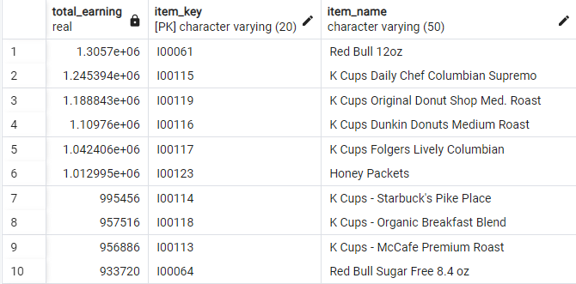
1. What items are generating the highest revenue?
SELECT SUM(total_price) AS total_earning, item_dim.item_key,item_name FROM fact_table
INNER JOIN item_dim
ON fact_table.item_key = item_dim.item_key
GROUP BY item_dim.item_key
ORDER BY total_earning DESC

Slide 3
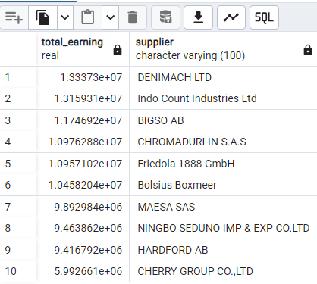
2. Which suppliers have the highest revenue amongst all?
SELECT SUM(total_price) AS total_earning,supplier FROM fact_table
INNER JOIN item_dim
ON fact_table.item_key = item_dim.item_key
GROUP BY supplier
ORDER BY total_earning DESC

Slide 4
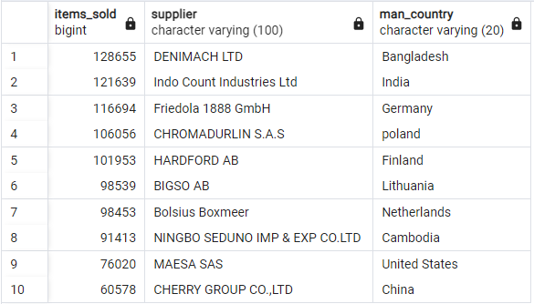
3. Which countries are leading in manufacturing?
SELECT COUNT(*) AS items_sold,supplier,man_country
FROM fact_table
INNER JOIN item_dim
ON fact_table.item_key = item_dim.item_key
GROUP BY supplier,man_country
ORDER BY items_sold DESC

Slide 5
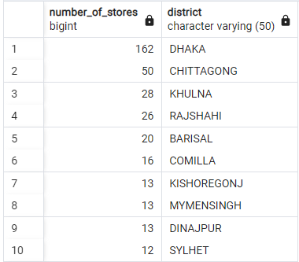
4. Which are the districts with the most number of stores?
SELECT COUNT(*) AS number_of_stores,district FROM store_dim
GROUP BY district
ORDER BY number_of_stores DESC

Slide 6
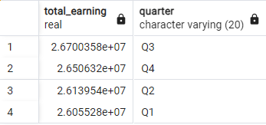
5. What is the relationship between quarter of the year and revenue generated?
SELECT SUM(total_price) AS total_earning,quarter FROM time_dim
INNER JOIN fact_table
ON time_dim.time_key = fact_table.time_key
GROUP BY quarter
ORDER BY total_earning DESC

Slide 7
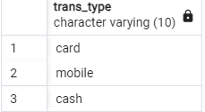
6. What are the types of payments customers have used?
SELECT DISTINCT trans_type FROM trans_dim

